Slide 1

TEEGALA KRISHNA REDDY ENGINEERING COLLEGE
(Approved By AICTE , Affiliated To JNTUH, Accredited By NBA And NAAC)
Department of Computer Science & Engineering
HEAD OF THE DEPARTMENT PROJECT CO-ORDINATOR
Dr. CH. V. PHANI KRISHNA Mrs. P.SWETHA
Professor Assistant Professor

Slide 2
Smart TPO Placement Management and Notification System
SUPERVISOR
P. Swetha
(assistant professor)
NAME OF THE STUDENTS

Slide 3
CONTENTS
ABSTRACT
INTRODUCTION
EXISTING SYSTEM
PROPOSED SYSTEM
REFERENCES

Slide 4
ABSTRACT
Campus placement processes often require manual screening of student profiles based on academic performance and skill criteria, leading to delays, errors, and missed opportunities. This project proposes an automated Placement Eligibility and Notification System that intelligently matches job requirements with student academic records, skills, CGPA, and backlog status stored by the Training and Placement Office (TPO). When a company posts a job, the system automatically shortlists eligible students and sends notification emails. This solution enhances efficiency, accuracy, and transparency while reducing manual effort, ensuring timely and fair opportunities for all students.

Slide 5
INTRODUCTION
Campus recruitment is a crucial process that connects students with employment opportunities. Traditionally, Training and Placement Officers (TPOs) manually review and filter student records to identify eligible candidates for each job posting, which consumes significant time and may lead to human errors. To streamline this process, an automated Placement Eligibility and Notification System is developed. The system maintains detailed student profiles and job requirements, automatically matches eligibility criteria, and instantly alerts qualified candidates. This automation improves transparency, reduces administrative workload, and ensures efficient and accurate student shortlisting.

Slide 6
EXISTING SYSTEM:
In the existing campus placement process, TPOs manually review student data, compare eligibility criteria, and communicate job opportunities individually. This method is time-consuming, prone to errors, lacks automation, and may delay notifications, reducing overall placement efficiency and fairness.
Drawback or Limitations
Time-consuming manual student filtering
High chance of human errors
Delayed communication to eligible students
Difficult to manage large student data
No automated skill-based matching
Lack of transparency and accuracy in shortlisting
Limited reporting and tracking features

Slide 7
PROPOSED SYSTEM:
The proposed system automates student eligibility matching based on academic data, skills, and job criteria. It automatically identifies eligible candidates, sends email notifications, and provides a dashboard for TPOs, ensuring faster processing, accuracy, transparency, and efficient placement management.
ADVANTAGES
Automated student eligibility filtering
Fast and accurate shortlisting
Reduces manual workload for TPOs
Immediate email notifications to students
Improves transparency and fairness
Efficient handling of large student data
Better placement insights and management

Slide 8
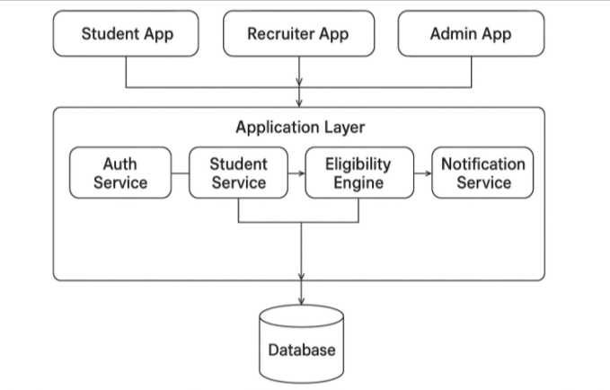
SYSTEM ARCHITECTURE

Slide 9
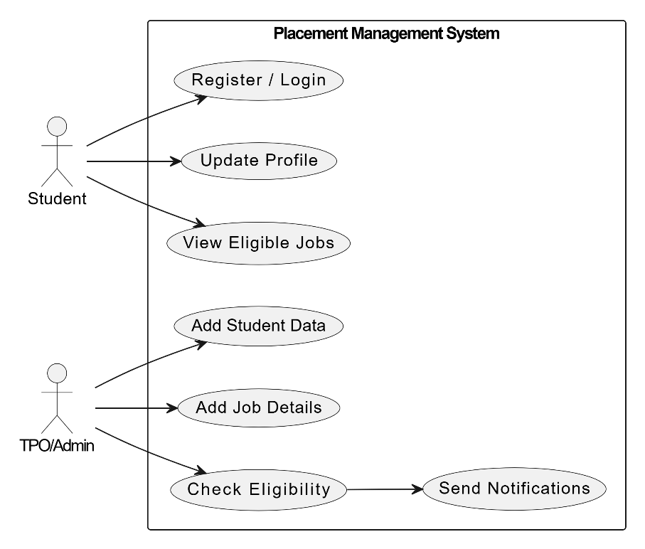
UML Diagrams
Use Case Diagram
Shows who uses the system (Student, TPO) and what they can do.

Slide 10
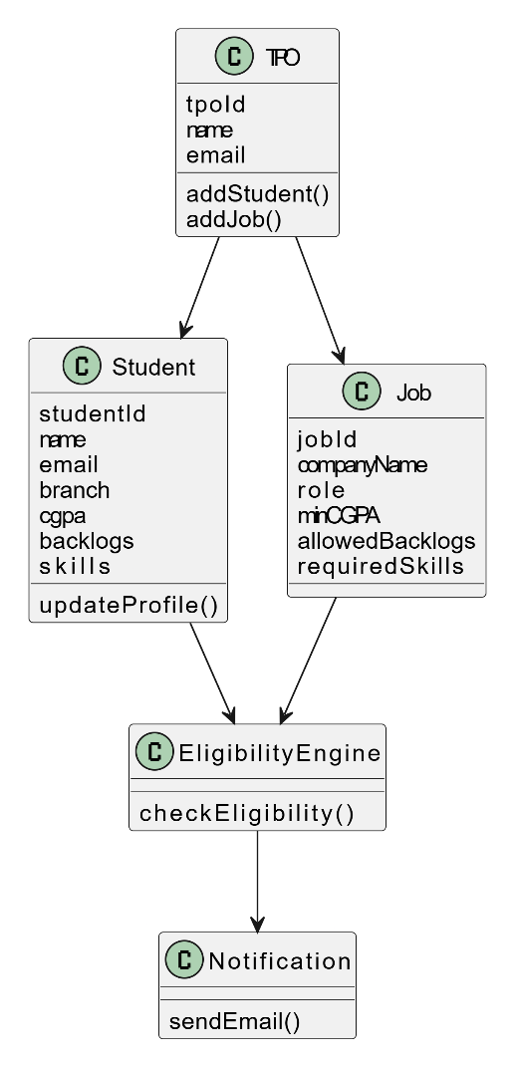
UML Diagrams
Class Diagram
Shows classes, attributes, and relationships (Student, Job, Eligibility).

Slide 11
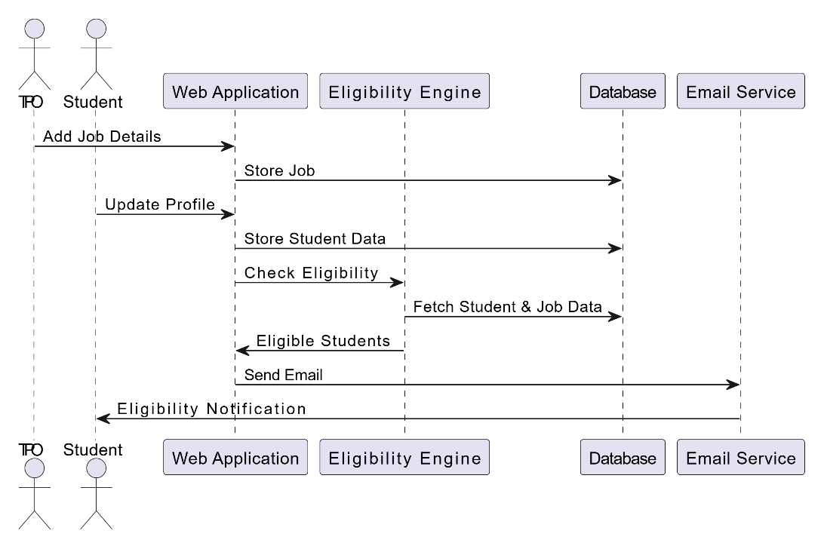
UML Diagrams
Sequence Diagram
Shows step-by-step interaction (Job approval → eligibility check → email).

Slide 12
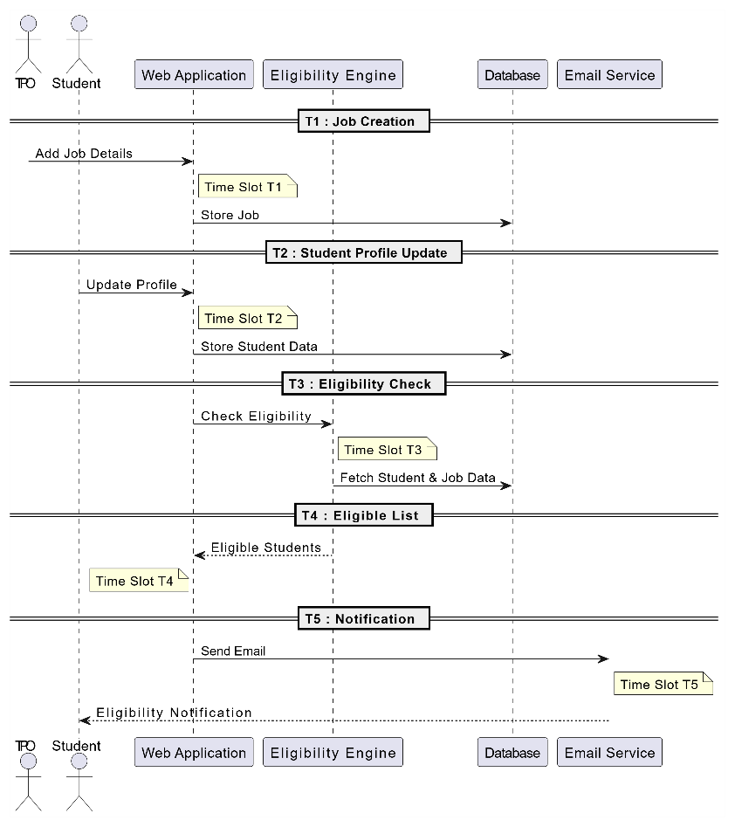
UML Diagrams
Sequence Diagram
Shows step-by-step interaction (Job approval → eligibility check → email).

Slide 13
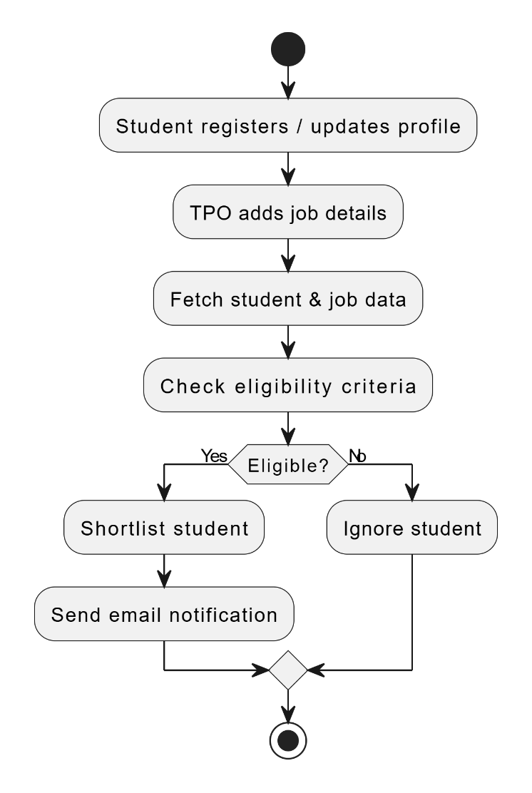
UML Diagrams
Activity Diagram
Shows workflow (Add student → approval → job posting → notification).

Slide 14
System Specifications
1. Hardware Requirements
Processor: Intel i5 or above
RAM: Minimum 4 GB (8 GB recommended)
Internet Connection (for email notifications)
2.Software Requirements
Operating System: Windows
Programming Language: Python 3.11.2
Framework: Django
Frontend: HTML, CSS, Bootstrap
Database: SQLite
IDE/Editor: VS Code
Web Browser: Google Chrome / Firefox
3. Technologies Used
Backend: Django (Python)
Email Service: Gmail SMTP
Database Management: Django ORM

Slide 15
MODULES
1. Admin/TPO Module
Manage student database
Add and update job postings
View shortlisted students
Monitor placement activities
2. Student Module
Student login and profile update
View eligible job notifications
Apply for jobs
3. Job Management Module
Store company/job details
Define eligibility criteria (CGPA, skills, backlogs, branch)

Slide 16
MODULES
4. Eligibility Matching Module
Automatically match student profiles with job criteria
Generate eligible student list
5. Notification Module
Send email alerts to eligible students
6. Reports & Analytics Module
Placement analytics
Eligibility reports and student statistics

Slide 17
REFERENCE
[1] S. K. Shah and P. R. Deshmukh, “Automated Student Placement System using Data Mining Techniques,” International Journal of Computer Applications, vol. 178, no. 25, pp. 1–5, May 2019.
[2] P. Singh and R. Garg, “A Smart Recruitment System Based on Skill Matching Using Machine Learning,” International Journal of Recent Technology and Engineering, vol. 8, no. 4, pp. 2102–2107, Nov. 2020.
[3] M. A. Chowdhury, M. R. Islam, and S. Hossain, “An Online Platform for Student Job Placement,” in Proc. IEEE Int. Conf. Computer and Information Technology, Dhaka, Bangladesh, 2018, pp. 54–59.

Slide 18
THANK YOU

